Slide 1

MM0005 MM Inventory Management
Goods Receipt
Storage
Movement of Goods
Goods Issue
Consumption
Reprocess Goods
Notes:
This In-house course was developed to meet the needs of SAP R/3 Consultants working at Capgemini
This course is designed to present a high level view of Materials Management Inventory management and to provide the Consultants with basic information about how to use this Functionality
More in-depth courses have been developed to train Consultants in specific areas discussed during this course
Your comments at the conclusion of this training session are appreciated and will help us better tailor future courses to meet your training needs

Slide 2
Inventory Management
PrepareMe
1
2
TellMe
3
ShowMe
4
LetMe
5
HelpMe

Slide 3
Inventory Management
PrepareMe
1
2
TellMe
3
ShowMe
4
LetMe
5
HelpMe

Slide 4
Course Objective
Overview of Inventory management and its usability.
Enter goods movements, including goods receipts, goods issues.
Describe the procedure for the initial entry of stock balances in the SAP system, enter a goods receipt without a purchase or production order, Goods receipt in different stock type,.
Enter a return delivery for goods receipt and subsequent delivery, Purchase order with a returns item and post the goods issue, goods movement posting reversal.
Tolerances and Delivery Completed Indicator.
Procedure for a stock-to-stock transfer posting, material-to-material transfer posting, one-step and two-step procedures for stock transfers, stock transfer from storage location to storage location, stock transfer between plants of a company code using the
one-step and two step procedures. Stock Transport Orders. Movement types.
Shelf life expiration.
structure of a reservation and the information it contains, reservation creation manually, with and without a reference.
Tips & Tricks
Test Your Knowledge & Answers

Slide 5

PrepareMe
In an organization ,an inventory is a is a list of goods and materials held available in stock by a business
A stock is basically cash held in disguise
For an organization Inventory may be termed as “for sale” or “for processing” or “not for sale”
Notes:
For an organization , accountants or the financial counterpart often discuss inventory in terms of goods for sale
For other organizations which are manufacturers,service providers and not-for-profits organizations - also have spme inventories (fixtures, furniture, supplies, ...) that they do not intend to sell, that which they intend for their own consumption to keep other important machines in running condition
Those are also inventory because they cost the organization for procuring it
Manufacturers',distributors, and wholesalers' inventory tends to cluster in warehouses.Retailers’ inventory may exist in a warehouse or in a shop or store accessible to customers.
For such cases, inventory is actually hard cash ,which they can earn by selling or by processing it.
Inventories not intended for sale to customers or to clients may be held in any premises an organization uses.

Slide 6
Purpose
PURCHASE
STOCK
Inventory management
FINISHED PRODUCT
REPROCESSING
CONSUMPTION
Inventory Management deals with the management of stock on a value basis or on a quantity basis or both
Inventory management also deals with movement of goods from one area to another within the same plant or between different plant which is logistically and physically located apart from each other
It also deals with reprocessing of stock to a different material or consuming it within the organization

Slide 7
Use
Inventory Management deals with Goods Receipt from vendors, Goods Issue and consumption
Through Inventory management an organization can actually track its level of inventory, i.e in true business terms it can calculate its inventory holding cost
Through Inventory management a stock item can actually be planned for procurement, i.e we can actually do materials planning
Inventory management also facilates stock movements between two locations within the plant or two facilities within the same plant or different plant, i.e it makes stock transfer possible
Inventory management also tracks special forms of procurement, such as Subcontracting (where although the material belongs to the organization but physically lies at a vendor’s premises), Consignment and Pipeline
PO Processing
Goods Receipt
Stock Movement
The most important elements in terms of Inventory Management are (a) the types of Goods Movement (b) the results of Good movement (c) the types of stock that it can handle.

Slide 8
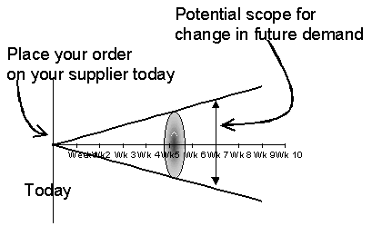
Challenges
Large business houses or organizations deals with a huge volume of inventory on a daily basis and there are different departments within the same organization working on the same , for example- purchasing, stores, processing, logistics
Wrong inventory management usually arises due to wrong forecasting or wrong materials planning (as shown above) ,purchase procures a higher quantity due to a bulk discount given by supplier, not accounting for the actual losses or in transit losses
Unchecked poor inventory management will manifest into a number of problems like –
Cost will rise.
Service level will fall.
Rise in quality issues
Notes:
Large levels of inventory generally require places to store them, people to look after them and staff to order as well as count them, and hence increase in cost
Poor inventory management will lead to fall in service level, because simply having more inventory is never the answer to delivering better service, as too often the inventory held is the wrong inventory or you cannot get to or see the correct inventory because the wrong inventory is in the way
Quality issues often arise as people use material that is there as opposed to the correct material or otherwise sometimes the material that is in stock is there because purchasing has done a good discount for a bulk deal
The vicious circle is that costs rise and service levels fall as quality fails

Slide 9
Inventory Management
PrepareMe
1
2
TellMe
3
ShowMe
4
LetMe
5
HelpMe

Slide 10
Inventory Management – Stock type
Unrestricted Use Stock
Quality Inspection Stock
Blocked Stock
Restricted Use Stock( If batch management status is active)
Valuated Stock
There are basically three types of stock types, unrestricted use, quality inspection stock and blocked stock.
Unrestricted-use stock:
This is company’s own stock that is physically located and is valuated, and is free for use.
Quality inspection stock:
This is also company’s own stock that is in quality inspection, and is valuated, but is not for free use.
Blocked stock:
This maybe company’s own stock , but cannot be used for Inventory management.

Slide 11

IM – Movement type
Goods Receipt to Warehouse
101
122
Vendor
Warehouse
Return to Vendor
The movement type is a very important control function in SAP, and it is defined by a three digit alpha numeric key
The movement type is used to differentiate various goods movement within an organization, for example- goods receipt, goods issue and transfer postings
The movement type controls which Financial stock or consumption account are to be updated. (this is also called automatic account determination)
The movement types control various screen settings while doing various goods movements

Slide 12

IM – Views in Mat Master Required
Warehouse Management Views
Purchasing View
Plant Storage view
Material master Views
Accounting View
Costing View
Notes:
Also Basic Data view is required
In addition to the above views for stockable material, quantity and value updation should be activated for material type settings in customizing

Slide 13
IM Management - Reservation
Controller
Store Manager
Warehouse
Reservation
=
Planning of Goods Movement
Planning of a Receipt.
Planning for a Transfer Posting
Planning for a Issue
Reservations are request to the Warehouse/plant for making a material ready for issue at a later date for a a particular purpose
A reservation ensures that a material is available at a particular date
Creation of a reservation in SAP generates a reservation number
A reservation is used to plan also an inward movement in advance

Slide 14
IM – Reservation Structure
Account Assignment
Base date
Header
Material
Requirement Date
Plant /Storage Locn/ Batch
Movement Allowed Indicator
Item
Item

Slide 15
IM – Settings for Reservation
Number range for Reservation
Dynamic Availability Check
Reservation Entered
Movement Allowed Indicator
Field Selection & Copying Rules
Days for movement allowed( 1 day)
Used for reservation mgmnt program
Holding Period for retaining( 2 day)
Notes:
If requirement date <= Current date +1 day , the n in the reservation management programe movement indicator is set.

Slide 16
IM – Goods Receipt
Vendor
Warehouse
Goods Receipt is done usually with reference to a Purchase Order which has been created by the procurement department
More than one Goods Receipt can be entered for a single Purchase Order
This applies to the case where there is a staggered delivery from a vendor
The goods receipt generates an internal document which is updated in the Purchase Order history
The above is a very simple pictographic example where a simple goods receipt takes place, although actual business scenario may be a little complex.
Goods Receipt updates the material stock in a plant ,and value for a valuated material

Slide 17
IM – GR Docs
Material Document
Accounting Document
Two documents are generated after Goods Receipt
Material Document
Accounting Document
Notes:
A material document is created soon as Goods Receipt , which is basically a proof of the transaction
If accounting are affected by the material movement, then accounting document is created in addition to the material document as an integration aspect that FI books are also affected
It is to be noted that as soon as a goods movement is posted, the quantities, material, movement type and organization structure (such as POrg, PGroup) can no longer be changed
If a document is to be corrected for errors , then a new document has to be created , by canceling/ reversing the incorrect document, which again will generate a reversing document number

Slide 18
IM – Effects of a Goods Receipt
Goods Receipt
Stock and Material Value gets updated
PO History and PO record gets updated
Material Document and Accounting Document gets generated
GR slip( Hard Copy) is generated
If Quality management is activated then, creation of an Inspection Lot to trigger quality inspection
Stock and Consumption account ( for a consumable material) gets updated
Notification of Goods Receipt electronically to vendor.( may be not for all situations)

Slide 19
IM – GR without reference to PO
Initial stock entry
Returns of defective product from customer
Receipt Without PO or production order
Requirement Date
Free goods receipt
A Goods receipt can also be carried out when a Purchase Order is not there, for example – Cash Purchase or small item purchase like flowers etc.
Movement type 501 is used for that
Both material document and accounting document is created( for a valuated and stock keeping material), where the valuation is done based on moving average price of a material
Initial uploading of stock entry movement type 561 is a type of GR without PO

Slide 20
IM – GR blocked stock
Conditional Acceptance
GR Blocked Stock, Movement type 103
A material that has been received subject to conditional acceptance (that is, damaged or unexpected deliveries) are usually posted to goods receipt blocked stock, depending upon the policy of the organization
Whenever a material is posted to GR blocked stock -
Quantities are posted to stock
The material is not valuated ,i.e. no accounting doc is generated
The transaction is entered in the purchase order history

Slide 21
IM – GR blocked stock and Release
PO History Updated
GR Blocked Stock updated
Release to Warehouse
Conditional Acceptance, GR Blocked Stock
OR
Return to Vendor
A material that has been received subject to conditional acceptance (that is, damaged or unexpected deliveries) , after it has fulfilled the acceptable conditions , can be released from GR Blocked stock
Whenever a material is released from GR Blocked stock, it can be transferred to the following stock -
Unrestricted-use stock
Stock in quality inspection
Blocked stock (valuated)
Notes:
If the goods are to be sent back to the vendor, we can send them back directly from GR blocked stock
This movement creates a material document and updates the purchase order history
Whenever a material is released from GR blocked stock the following happens:
Material and financial accounting documents are created
Total valuated stock is updated
Purchase order and purchase order history are updated
The G/L accounts are updated

Slide 22
IM – Goods Receipt in Quality Inspection
Quality Inspection Indicator is set in the following
In Material Master
Purchase Order
In Purchase Order
At the time of Goods Receipt
Notes:
We can post goods receipts from vendors to quality inspection stock for the following reasons:
If the material master has got the quality inspection indicator set, then a material always has to undergo quality inspection before it is used.
If a material is received from a particular vendor for a first time and has to undergo quality inspection first.
At the time of goods receipt that the material has to undergo quality inspection, for example, because you established that the packaging is damaged and suspect that the goods were
also damaged during transportation.

Slide 23
IM – Setting the Delivery Completed Indicator
Setting the “Delivery Completed Indicator”
Purchase Order
A Delivery Completed Indicator can be set at the time of creation of Purchase Order or at the time of Goods Receipt

Slide 24

IM – Under delivery and Over delivery
Under delivery -15%
Over delivery -25%
60
85
100
125
150
Under delivery –Warning Message
Over delivery – Error Message
No message within tolerance Range
Notes:
Whenever a Goods Receipt is done , SAP compares the GR quantity with the quantity in the open
purchase order and thereby identifies underdeliveries or overdeliveries
If the quantity of goods received is smaller than the ordered quantity minus the underdelivery tolerance, this is interpreted and accepted as a
partial delivery
If over-deliveries are to be allowed, we can specify a percentage overdelivery tolerance in the order item.

Slide 25
IM – Under delivery and Over delivery Customizing & Application
The following configuration can be set as per the requirement
Tolerance Limit
Any variances in GR ?
Should the ‘Delivery Completed Indicator be set Automatically ?
Set Delivery Complete Indicator

Slide 26
IM – Stock Transfers
Stock Transfers
Transfer Postings
Plant to Plant
Material to Material
Storage Locn. To Storage Locn.
Consignment to Warehouse
Quality Inspection to un-restricted use.
Transfer Posting
Change of Stock Type, Material Number or batch number
A physical movement can also take place
Stock Transfers
Physical Movement takes place
It can be one step or a two step depending upon the scenario
Notes:
Examples of transfer postings include release from quality inspection or transfer from consignment material to company’s own stocks.
The R/3 System creates a material document so that the transaction can be entered. Documents in Financial Accounting (FI, CO, CO-PC) are created only if there is a stock change involving
valuation (for example, goods are transferred from one plant to another).

Slide 27
IM – Stock Transfers- Storage Location to Storage Location
Unrestricted Stock
Unrestricted Stock
This type of transfer always takes place within a plant
Material document is generated, but no accounting document since there is no change in valuation
There is only a physical movement of stock

Slide 28
IM – Stock Transfers- Plant to Plant- One step
Unrestricted Stock
Unrestricted Stock
Goods Receipt
Goods Issue
This type of transfer always takes place from a plant to another plant
Goods issue is being done from the despatching plant
Material and accounting document is generated as because there is change in valuation
As and when Goods Issue is done in the despatching plant, the receiving plant stock increases at the same time

Slide 29

IM – Stock Transfers- Plant to Plant- Two step
Unrestricted Stock
Goods Issue
Goods Receipt
Unrestricted Stock
This type of transfer always takes place from a plant to another plant.
Goods issue is being done from the despatching plant.
Material and accounting document is generated as because there is change in valuation.
As and when Goods Issue is done ,the stock goes into a in-transit stock.
Notes:
This process starts only after the issuing/ despatching plant receives a Purchase order from the receiving plant.
The issuing/ despatching plant then issues the material from its unrestricted use stock, against that PO.
Movement type 351 is generally used.
These types of Purchase Orders are usually called ‘Stock Transport Order’.

Slide 30
IM – PO quantity variance
Purchase Order
VARIANCE= 10%
Possible reactions-
No message
Warning plus mail mess.
Error message
These are Dependent on B1 and B2 tolerances (Customizing)
Notes:
It is to be noted that Goods receipts are valuated on the basis of the incoming quantities in the order price unit.
Invoice verification is also based on the GR quantity in the order price unit.

Slide 31

IM – Reversals and Return Deliveries
Reason for movement
(optional entry)
(e.g., wrong storage. location.)
Reason for movement
(mandatory entry)
(e.g., material damaged)
Without
Goods receipt/issue slip
With
Return delivery slip
Notes:
The “reason for movement” specified during a Goods Return can also be determined per movement type.
The “reason for movement” , can also be configured ,so as to enable an analysis and display of vendor problems (for example,
damaged packaging).
Whenever there is a return of material to a vendor, we can specify a reason for movement individually for each
item or enter a reason for movement on the initial screen for goods movements.
It can be configured that whether a goods receipt/issue slip or a return delivery slip is to be printed , depending on the movement type.

Slide 32
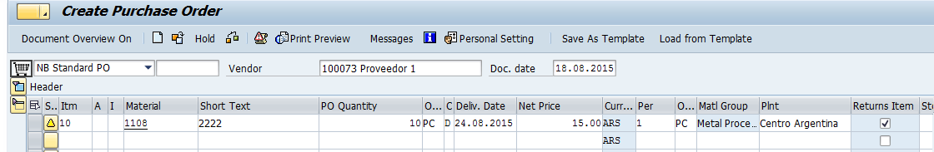
IM – Returns Purchase Order
The return PO indicator in a Purchase Order determines whether it is a Return PO as shown
Returns Indicator
Goods Receipt for such a PO will be with Movement type 161
Such a Goods Receipt creates Material Document and an Accounting Document also
Notes:
Returns to vendor are return deliveries of material from a plant to an external vendor.
For returns to vendor, we do not have to refer to the preceding document i.e the PO number in which it was purchased.
For movement type 161, configuration can be done so as to generate a PO in the background.

Slide 33

IM – Goods Receipt Message
If latest acceptable Goods Receipt date has been entered in the PO, and Goods Receipt is being done after that date, SAP can be configured to give either an error or a warning message
Posting Date 12.29
OK
Vendor
NOT OK
Error or Warning Message

Slide 34
Inventory Management
PrepareMe
1
2
TellMe
3
ShowMe
4
LetMe
5
HelpMe

Slide 35
Goods Receipt

Slide 36
IM – Goods receipt
Single Transaction
Goods Receipt for known PO
Release Blocked Stock.
Goods Receipt for unknown PO
MIGO
Enter Subsequent Delivery.
Goods Issue
Do postings of stock transfer
Display Material Doc for Goods receipt
Cancel Material Doc for Goods receipt
Notes:
In the MIGO ,we can use the following functionalities:
. Goods receipt for known purchase order
. Goods receipt for unknown purchase order
. Enter return delivery
. Release blocked stock
. Enter subsequent delivery
. Cancel material document for goods receipts
. Change and display material document for goods receipts.
In Customizing for Inventory Management, we can define which fields appear on the which of the above transaction screen and how they appear, by choosing Goods Receipt ® Define Field Selection for Header/Detail Fields and Table Columns.

Slide 37
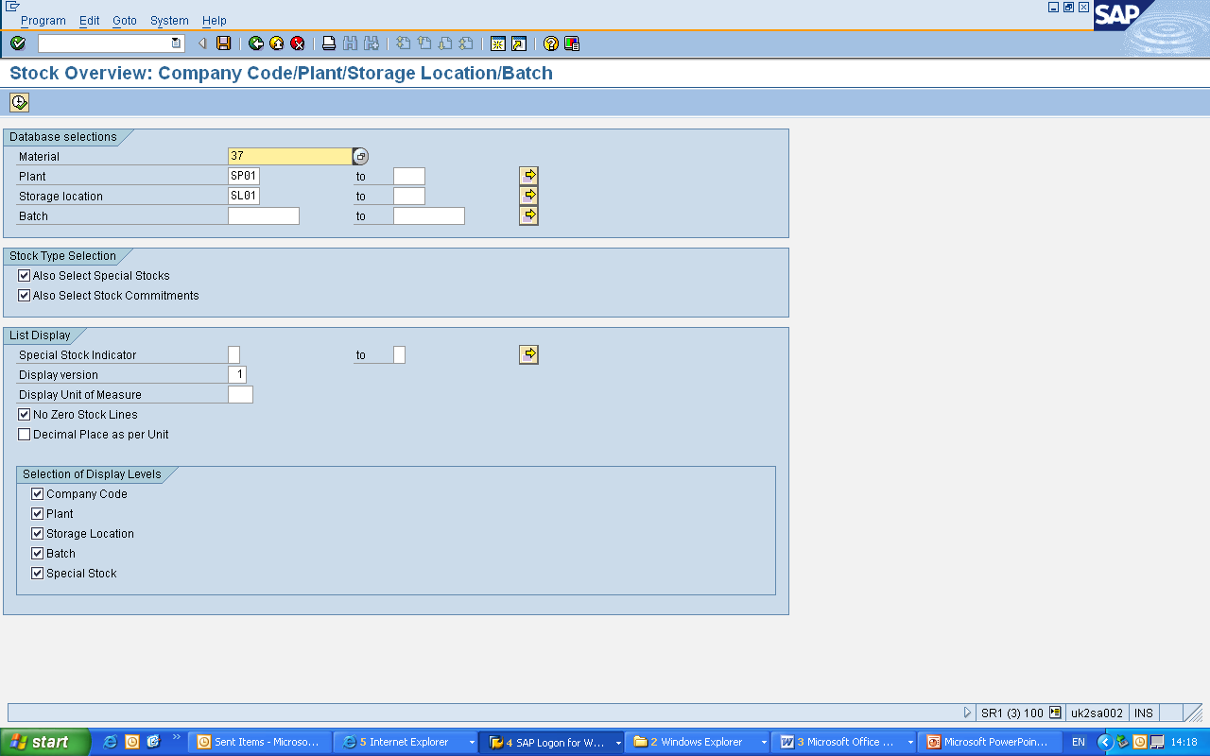
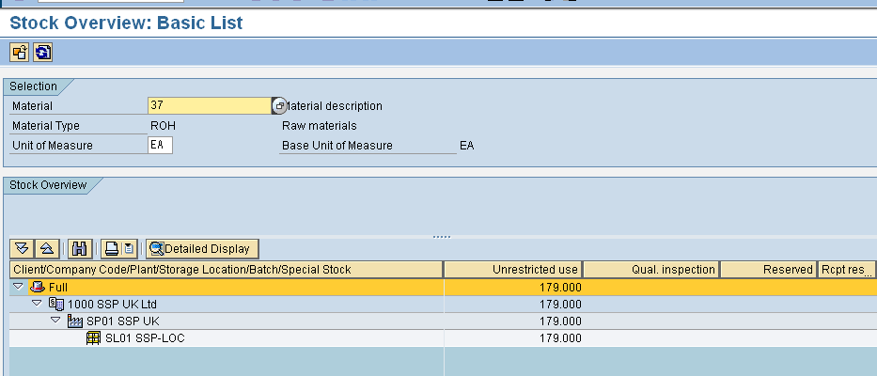
IM – Goods Receipt
Stock Overview
Logistics -> Materials Management -> Inventory Management -> Environment
-> Stock -> Stock Overview
T Code- MMBE

Slide 38
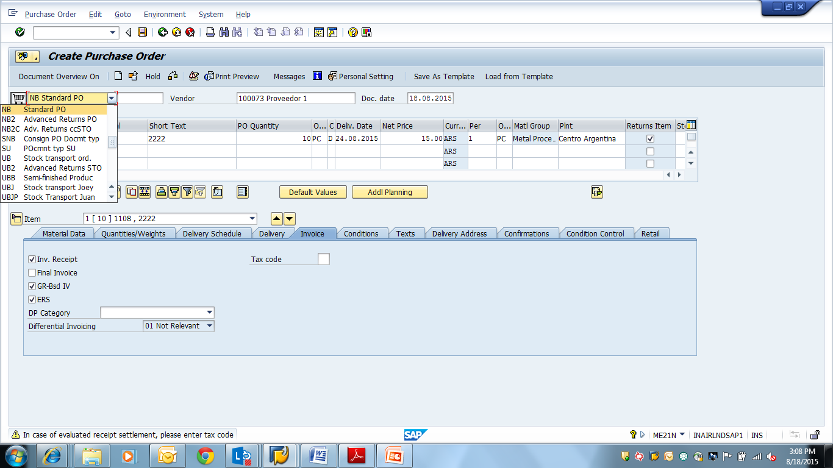
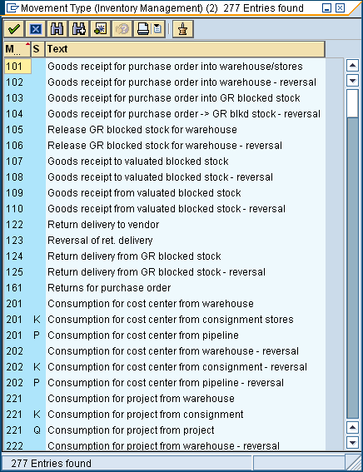
IM – Goods Receipt
Goods Receipt
Goods Movement -> Goods Receipt -> For Purchase Order -> Goods Receipt
from External Procurement
T CODE- MIGO
Movement type: 101- GR to unrestricted use stock
Movement type: 103- Goods Receipt to GR Blocked Stock

Slide 39
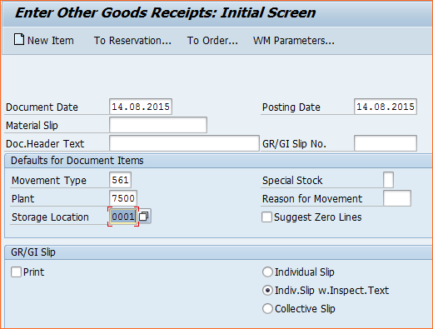
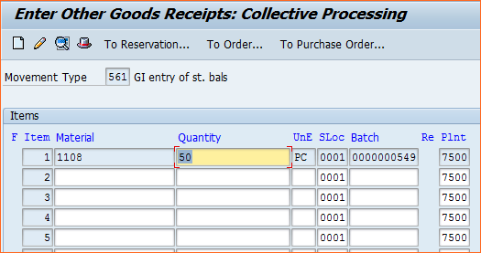
IM – Goods Receipt
Goods Receipt- Initial Stock Entry
Goods Movement -> Goods Receipt -> Others, then choose Movement type ->
Receipt -> Initial stck entry (own) -> To unrestricted.
T CODE- MIGO
Movement type: 561

Slide 40
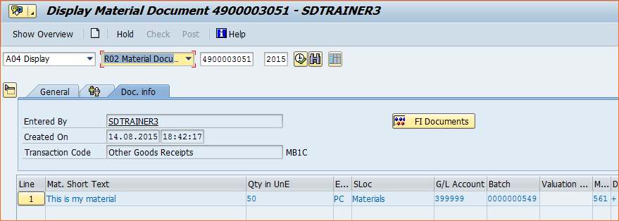
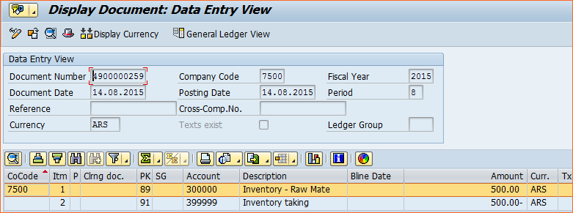
IM – Goods Receipt
Display Material Document.
Material Document -> Display, then choose FI documents
T CODE- MIGO
Clicking on the Accounting Document displays it, and we can view the GL/ac’s that it has updated.

Slide 41


IM – Material to Material Conversion
309
310
Material to Material transfers requires that both material is managed in same units of measure
Material document is generated
An accounting document is generated if the moving average price in the accounting view of both the materials is different , i.e. there is a change in valuation price
Notes:
Movement type 309 is used and for reversing it movement type 310 is used.

Slide 42
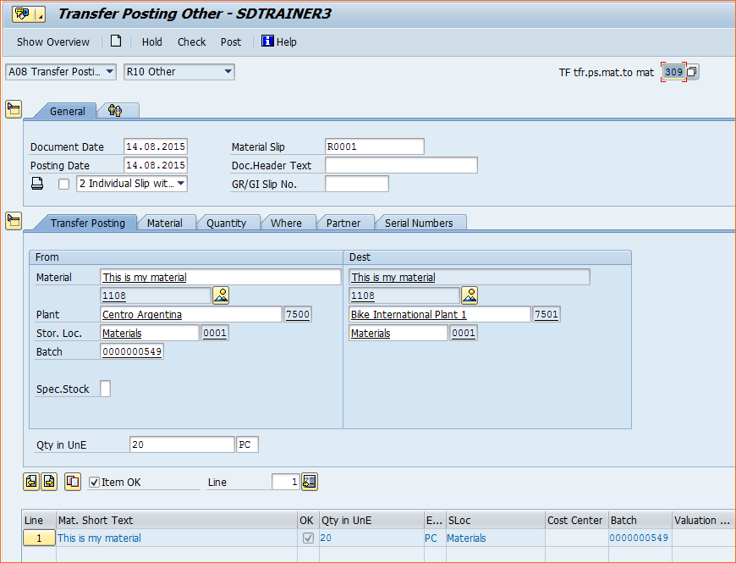
IM – Inter Product Movement
Inter Product Movement.
T CODE- MIGO
Movement type: 309- Conversion of a material into a different material
Movement type: 310- Reversal of 309 movement
Notes:
Choose in the MIGO header screen-
‘A08-Transfer Posting’ and ‘R10-Others’.

Slide 43
Transfer Posting

Slide 44

IM – Transfer Postings
Quality Insp. Stock
321
322
350
349
Unrestricted use Stock
344
343
Blocked Stock
Notes:
Whenever a transfer posting is carried out, the stock type, batch number is changed
As discussed previously SAP creates a material document so that the transaction can be entered
An accounting document is created if a change in material valuation is involved
A transfer posting may also involve an actual physical stock transfer

Slide 45
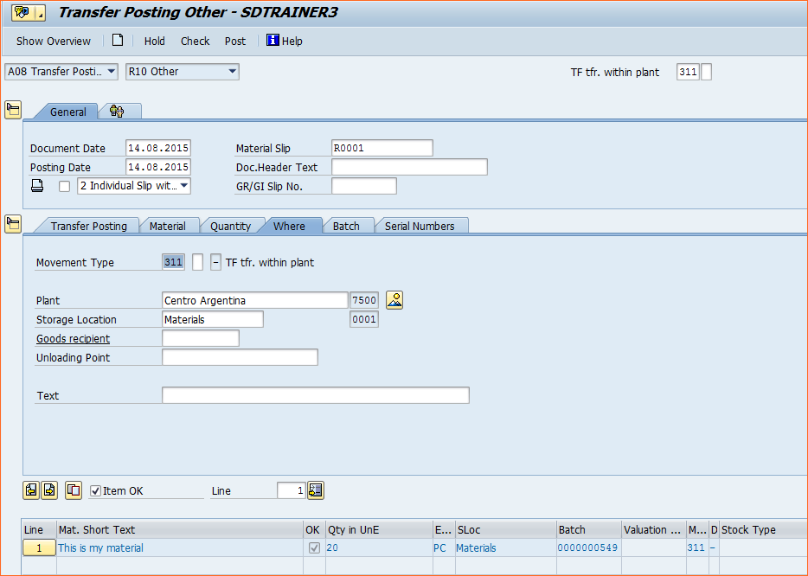
IM – Transfer Posting
Storage Locn to Storage Locn
Goods Movement -> Transfer, then choose Movement type -> Transfer posting ->
Stor. loc. to stor. loc -> Unrestricted to Unrestricted
T CODE- MIGO
Movement type: 311
Movement type: 312 – Reversal of that documents
Notes:
Choose in the MIGO header screen-
‘A08-Transfer Posting’ and ‘R10-Others’

Slide 46
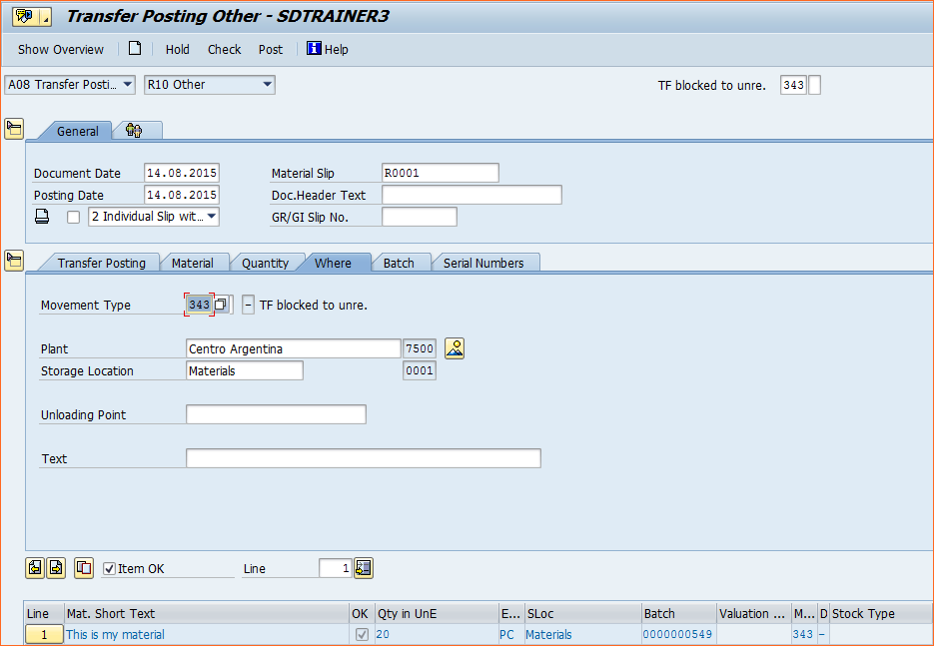
IM – Transfer Posting
Storage Locn Blocked to Unrestricted
Goods Movement -> Transfer, then choose Movement type -> Transfer posting ->
Stock to stock -> Blocked to unrestr
T CODE- MIGO
Movement type: 343
Movement type: 344 - Reversal of 343, i.e unrestricted to block.
Notes:
Choose in the MIGO header screen-
‘A08-Transfer Posting’ and ‘R10-Others’.

Slide 47
Reservation-Create & Change

Slide 48
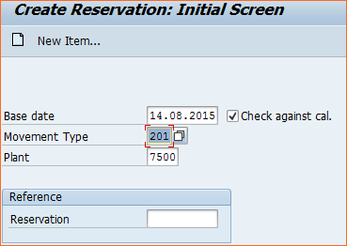
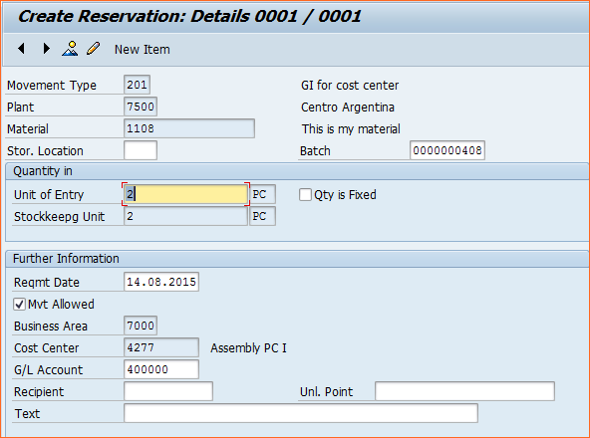
IM – Reservation- Create
Create reservation
Inventory Management -> Reservation -> Create, then choose Movement type ->
Consumption -> For cost centre
T CODE- MB21
Movement type: 201
Create reservation with reference to another
Inventory Management -> Reservation -> Create. In the Ref. Reservation field,
enter the reservation from above

Slide 49
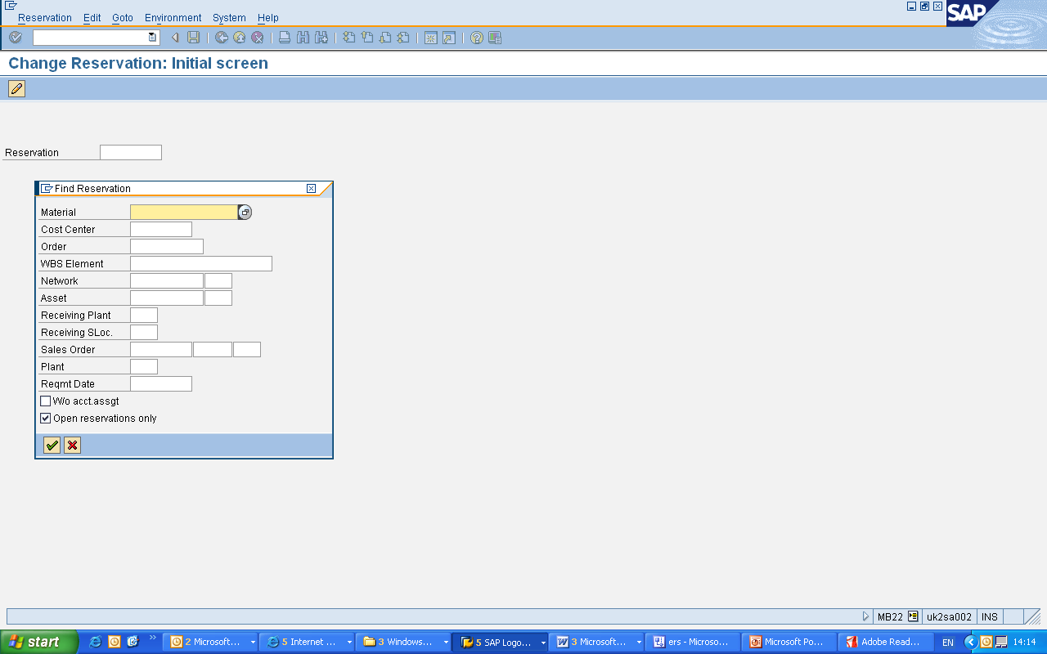
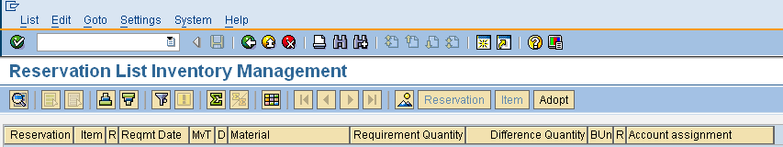
IM – Reservation- Change
Create reservation
Inventory Management -> Reservation -> Change, then choose Go To -> Header
Reservation -> By material
We enter the material numbers in the From and To fields on the initial screen
Give movement type 201, and all issue reservations are listed for each material
T CODE- MB22

Slide 50
IM – Auto PO Creation
It can be configured in IMG , such that for a particular movement type system generates a PO in the background.
Purchase Order (in background)
Automatic PO Generation settings can be in following-
Vendor
Notes:
The valuation at the time of Goods Receipt in these cases are usually done as per the Purchase Info Record or the Material Master valuation price.
Automatic PO can be generated only for valuated material.

Slide 51
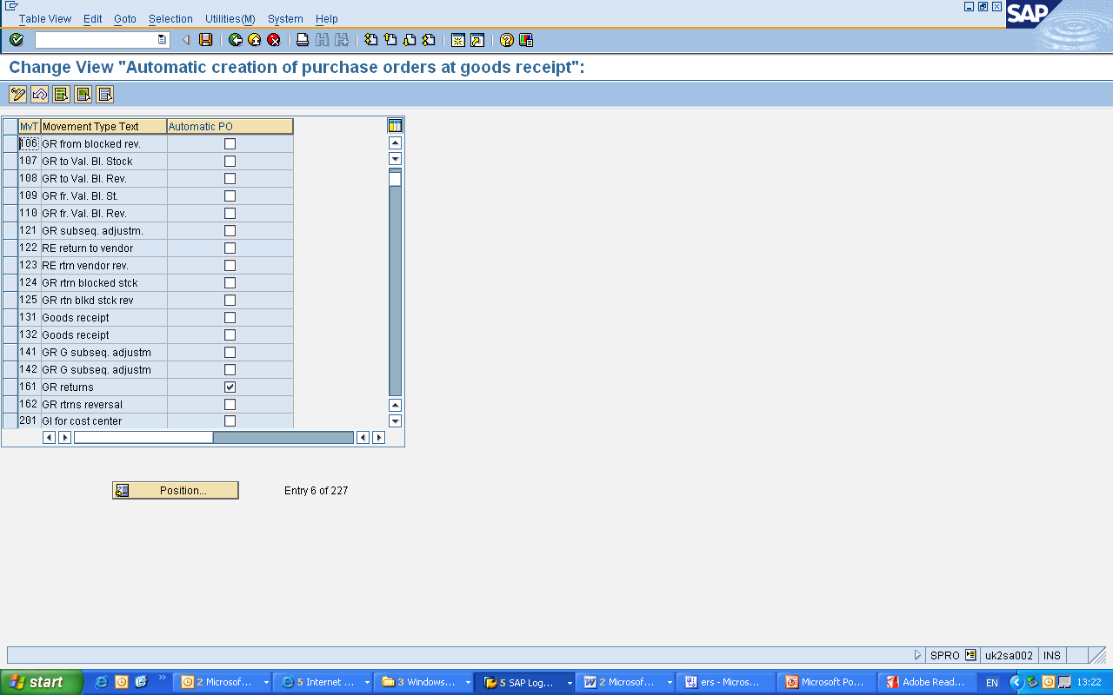
IM –Auto generation of PO
Customizing setting for Auto Generation of PO
Materials Management -> Inventory Management and
Physical Inventory -> Goods Receipt -> Create Purchase Order Automatically
Then click on the box against movement type for which Auto PO is to be configured
Notes:
Also
Auto PO indicator has to be set in Material Master- Purchasing View.

Slide 52
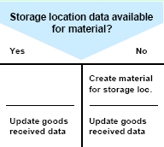
IM – Creating Storage Locn Automatically
The following settings are required for SAP for creation of Storage Location in the background
Activate for Plant
During Goods Movement
Activate for movement type
Maintain in Material Master

Slide 53
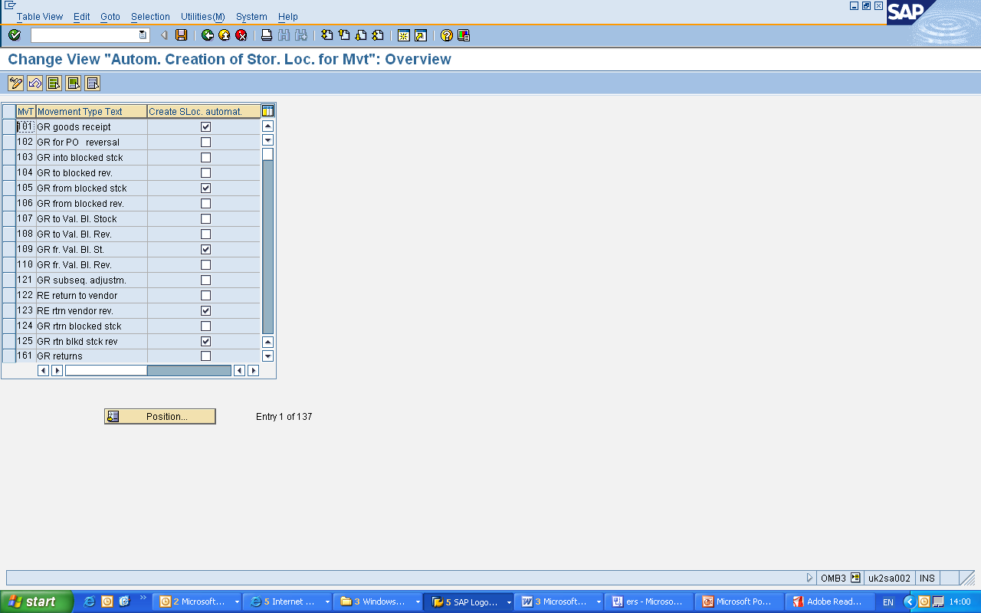
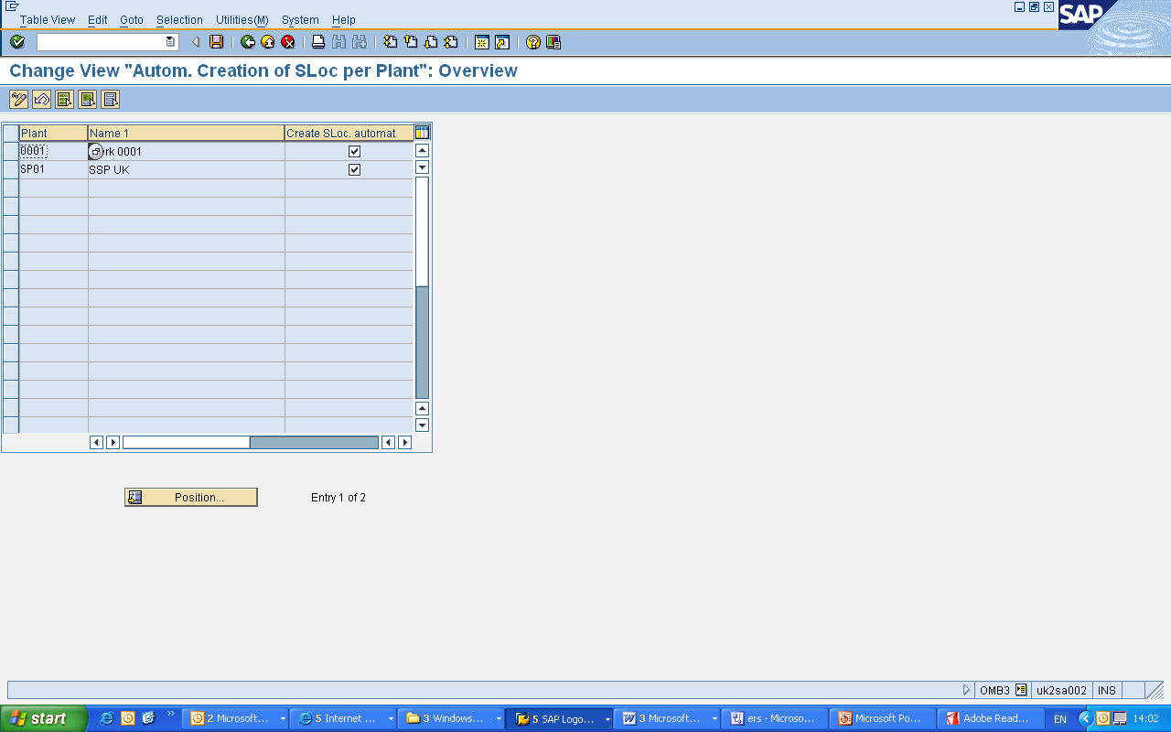
IM – Auto Create Storage Location
Customizing setting for Creation of Storage Location Automatically
Materials Management -> Inventory Management and
Physical Inventory -> Goods Receipt -> Create Storage Location automatically
Then click on the box against, either ‘Plant’ or against ‘Movement Type’

Slide 54
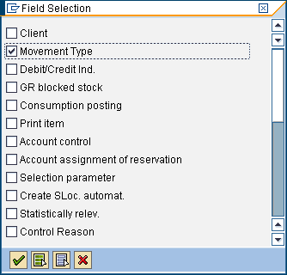
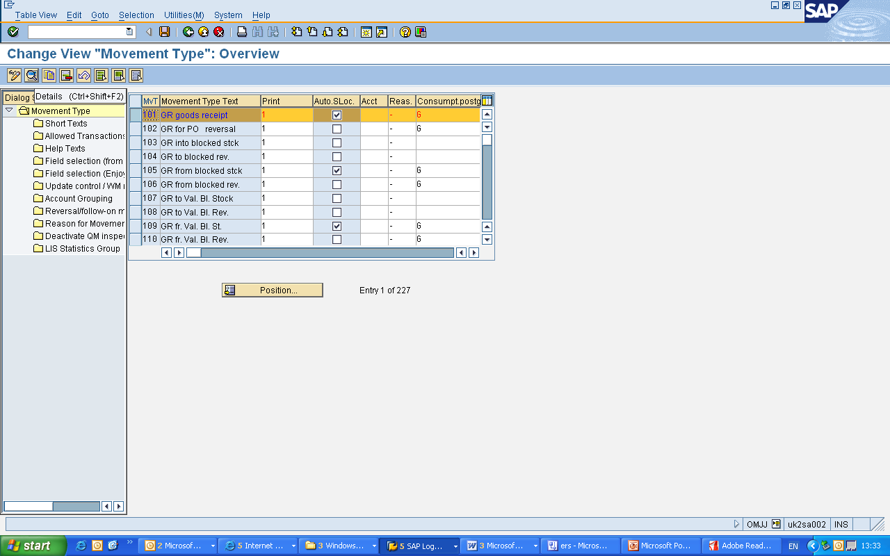
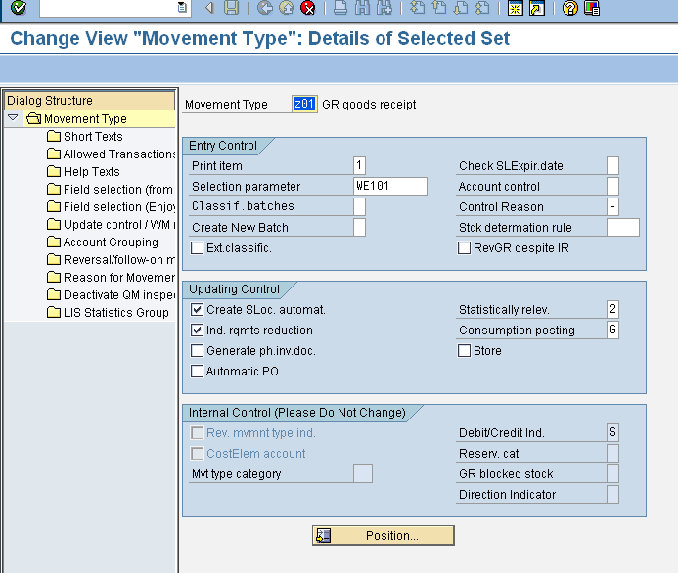
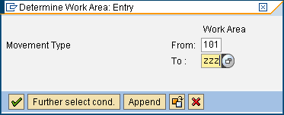
IM – Creation of New Mvmnt type
Customizing setting for creation of a Movement Type
Materials Management -> Inventory Management and
Physical Inventory -> Movement types -> Copy change Movement type
Click on the icon and then select Movement type and press enter
Then select a movement type and then choose copy as,
Make desired entries and then click ‘Save’

Slide 55
Stock Transport Order – 2 step

Slide 56
IM – Stock Transport Order – 2 step
Setting for Stock Transfer Order 2 step
Logistics -> Materials Management -> Purchasing -> Purchase order -> Create -> Vendor/supplying plant known, then choose Stock transport Order
Post Goods Issue for Stock Transport Order
Movement type -> Transfer posting ->Plant to plant -> To stock in transit.
Note: On the initial screen, enter the purchase order number in the dialog box.
Movement type: 351
Post Goods Receipt for Stock Transport Order
In the above Goods Issue was done for the STO
Logistics → Materials Management → Inventory Management → Goods Movement → Goods Receipt → For Purchase Order → PO Number Known
T CODE- MIGO
Movement Type- 101

Slide 57
Goods Issue

Slide 58
IM – Goods Issue
From warehouse-unrestricted
From Consignment stock
From pipeline stock
Consumption
Issue
Goods Issue can be done against cost centre, assets, sales order or an Internal Order
In all the cases a material document gets created and an accounting document also
In case of Accounting document, it will debit either to the expense account or an asset or a sales order or an internal order

Slide 59
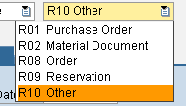
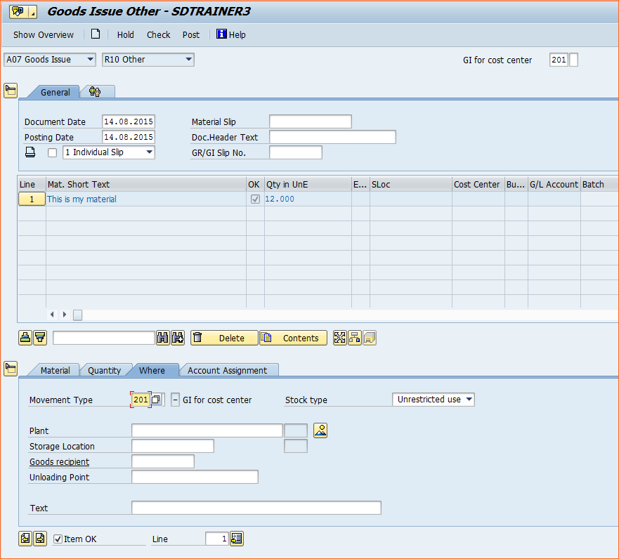
IM – Goods Issue
Post Goods Issue
Movement type -> Goods Issue -> Select any one option
Four options can be chosen for Goods Issue as
Post Goods Issue against Cost Centre
Movement type -> Goods Issue -> Others
Movement type- 201

Slide 60
Inventory Management change of data model in S/4HANA

Slide 61
All data for material documents in one table : MATDOC
With S/4HANA this data model has been changed significantly. The new de-normalized table MATDOC has been introduced which contains the former header and item data of a material document as well as a lot of further attributes. Material document data will be stored in MATDOC only and not anymore in MKPF and MSEG. Additionally the aggregated actual stock quantities will not be persisted anymore in the hybrid or replaced aggregation tables. Instead, actual stock quantity data will be calculated on-the-fly from the new material document table MATDOC for which some of those additional special fields are used. Hence, with the new MM-IM data model the system will work on database level in an INSERT only mode without DB locks. Nevertheless, for stock decreasing processes there will be still ABAP locks to ensure stock consistency. A further advantage of the new MM-IM data model is the capability of simple and fast reporting because the most information is all in one place: MATDOC.

Slide 62
Impact of change of data model in MM-IM
No business impact while using standard tables except where custom code or customer APPENDs or INCLUDEs with customer fields & data therein on the tables mentioned in the note 2206980 have been used.
Hence performance critical customer coding may be adjusted to improve performance.
Furthermore customer coding writing data to aggregated actual stock quantity or to the former document header or item table shall be adjusted!

Slide 63
Customer views on MKPF/MSEG
Impact :
Views are database objects and thus a view is executed on the database. Because the table MKPF and MSEG will not contain data anymore (except legacy data from migration) such a customer view will never return any record. Such views have to be either adjusted by fetching data from table MATDOC or to be created new as DDL source with a different name. In the last case all usages of the old DDIC SQL view must be replaced by the new CDS view.

Slide 64
Reporting

Slide 65
IM – Reporting
List of material documents
Accounting documents for
material
Canceled material documents
Material documents with
reason for movement
Report for analysis of
rounding differences
Stock overview
Stock / requirements list
Availability of plant stock
Availability overview
Stocks with subcontractor
Material stock at entry date
GR/IR balances list
Display of stock in transit

Slide 66
IM – Reporting MM
Following are the list of standard reports in MM
Note that some rely on LIS records, so it must be activated:
MB51 Material Doc. List
MB5L List of Stock Values: Balances
MBBS Display valuated special stock
MC$G PURCHIS: Material PurchVal Selection
MC$I PURCHIS: Material PurchQty Selection
MC.1 INVCO: Plant Anal. Selection: Stock
MC.2 INVCO: Plant Anal.Selection, Rec/Iss
MC.5 INVCO: SLoc Anal. Selection, Stock
MC.9 INVCO: Material Anal.Selection,Stock
MC.A INVCO: Mat.Anal.Selection, Rec/Iss
MC.L INVCO: Mat.Group Analysis Sel. Stock
MC48 INVCO: Anal. of Current Stock Values
MC50 INVCO: Analysis of Dead Stock

Slide 67
IM – Reporting MM (cont)
Following are the list of standard reports in MM
MCBA INVCO: Plant Analysis Selection
MCBC INVCO: Stor. Loc. Analysis Selection
MCBE INVCO: Material Analysis Selection
MCBK INVCO: MatGrp Analysis Selection
MCBR INVCO: Batch Analysis Selection
MCE1 PURCHIS: PurchGrp Analysis Selection
MCE3 PURCHIS: Vendor Analysis Selection
MCE5 PURCHIS: MatGrp Analysis Selection
MCE7 PURCHIS: Material Analysis Selection
MCW3 PURCHIS: Evaluate VBD Header
MCW4 PURCHIS: Evaluate VBD Item
ME2L Purchase Orders by Vendor
ME2M Purchase Orders by Material
ME2N Purchase Orders by PO Number
MIR6 Invoice Overview
MMBE Stock Overview

Slide 68
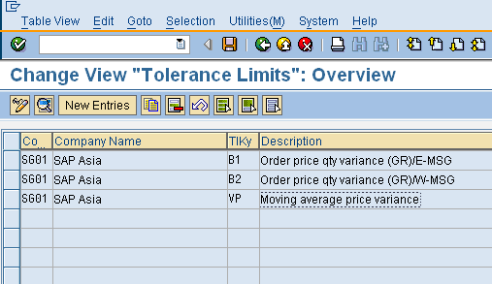
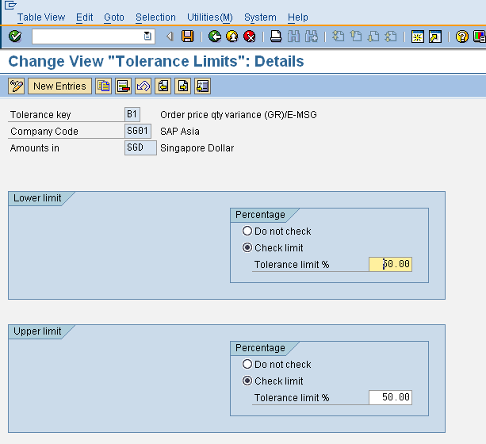
IM – Tolerance Limit
Customizing setting for Tolerance Limit
Materials Management -> Inventory Management and
Physical Inventory -> Goods Receipt -> Set Tolerance Limits
Maintain Tolerance limit for Company Code for Tolerance Key B1,B2 and VP

Slide 69
Shelf Life

Slide 70
IM – Shelf Life Expiration Date Check
Vendor
OK
Shelf Life OK
NOT OK
SLED activated in Material Master
Error or Warning Message
Notes:
For the shelf life expiration date (i.e SLED in short form) to be activated, if all the following has been maintained :
The minimum remaining shelf life has been maintained in the material master or the purchase
order
The minimum remaining shelf life value is the number of days that a material has to be usable in
order that the R/3 System will accept the goods receipt.
The shelf life expiration date check is active in the plant.
In the IMG configuration the shelf life expiration date check is activated for this movement type.
If the shelf life expiration date check is activated, then at the time of Goods receipt we need to enter the expiration date or production
date of the material .
At the time of entering the goods receipt, the R/3 System checks whether the minimum remaining shelf life
meets the requirements entered in the purchase order or the material master.
The system then issues a warning message or error message, depending on how the message setting has been configured.
The shelf life expiration date can be printed on the goods receipt/issue slip.

Slide 71
IM – Shelf Life Setting
The following settings are required for SAP to check the shelf life expiration date
Activate for Plant
Print in the GR slip
Activate for movement type
Record Shelf Life at the time of Goods Receipt
Maintain record in Material Master

Slide 72
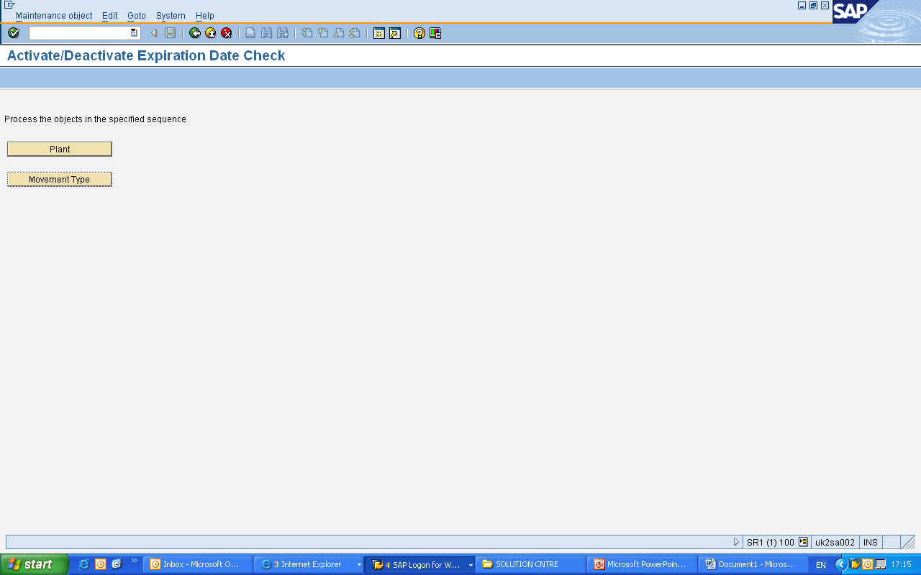
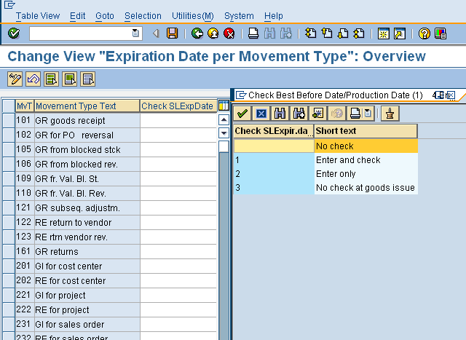
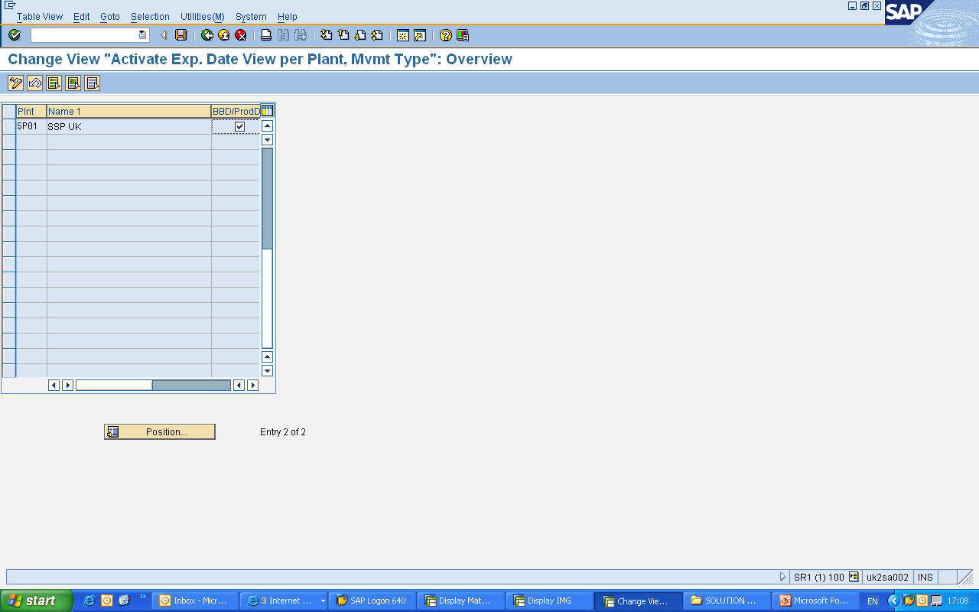
IM – Setting for Shelf Life
Customizing setting for Shelf Life check
Materials Management -> Inventory Management and
Physical Inventory -> Goods Receipt -> Set Expiration Date Check
Then click on the box against, either ‘Plant’ or against ‘Movement Type’
Notes:
The shelf life expiration date of a material can only be entered if the minimum remaining shelf life is maintained in the material master record. The minimum remaining shelf life is the time the material must still be usable, so that the goods receipt is accepted by the system.
If the shelf life check expiration date check is active, we must enter the shelf life expiration date or the production date of the material at the time of a goods receipt.
At the time of goods receipt, the system checks whether the remaining shelf life is sufficient.
If this is not the case, a warning or error message is issued, depending on the system settings.
When the goods receipt is posted, the shelf life expiration date is recorded in the material document.

Slide 73
Inventory Management
PrepareMe
1
2
TellMe
3
ShowMe
4
LetMe
5
HelpMe

Slide 74
Let me
Case Study
ABC Corporation has business setup in UK and India with its head quarter
based in London.
It is in the business of manufacturing fast moving Food products, and has a very highly sophisticated warehouse, where all its products are being stored.
Its plant is located in London, and Glasgow in Scotland ,and both the plant procures material from various suppliers located all over the UK. Since this is a fast moving business , strict quality standards are being maintained, before and product is being taken in.
It has various storage locations named based on the Ambient temperature. For example meat is stored in a refrigerated environment, while bread is stored in an ambient environment.
Do the following-
Create a material master for chicken legs ( for material Type ROH), such that it contains, basic Data, Purchasing, General Storage, Quality management, Accounting and Costing view
Update Initial Stock of 100 KG. Check the material and accounting documents generated
Create a PO for London plant 2000 KG, and then receive the material in quality
Check the stock overview, and after the material is released from quality check the stock overview
The Glasgow plant immediately requires 500KG, since it has run a stock out situation and its supplier will take another 10 days to deliver, due to some problem in his yard. Hence its has requested its London plant to send a stock of 500 KG.

Slide 75
Let me
Do the following-
Extend the material chicken legs for Glasgow plant
Create a Stock Transport order, where the supplier plant is London plant and receiver plant is Glasgow plant. Note down the PO No
Use this PO Number to do a Goods issue to ‘Stock-in-Transit’
Check the material document and accounting document so generated
The Glasgow plant has now received the consignment next day, but it has found that one crate containing 10KG seems damaged
Receive 10 KG in GR blocked stock and the rest in quality stock
Yesterday there was a Power Outage in one of the chilled area where Chicken Legs were kept in London plant. Hence the shop manager decided to move the stock of that storage location amounting to 250 KG to blocked stock
Move the 250 KG to blocked stock and see the material and accounting document
The sales department has got a huge order of 2500 KG chicken legs-tendered to be delivered to a customer after 15 days. They checks the stock and finds that it is below requirement and hence decided to raise an order for that quantity to the stores department
Create a reservation of the remaining amount of stock

Slide 76
Let me
Task 1
Business requirement: You plan to transfer part of the stock of material (Which you have created) to another
warehouse. You create a reservation manually to achieve this.
Do the following-
Step 1: Create a reservation for a transfer posting of 10 pieces materials (which you created and check stock availability) from plant 1000, storage location 0001, to storage location 0002. Check if Storage location 0002 exists. The stock transfer is to be executed in one week. Note the reservation number.
Step 2: You have just heard that the first stock transfer can only start in 2 weeks. Change the base date of the reservation from step 1-1 by one week to <today +14 days>.
Step 3: Display the reservation stocks of material in the stock overview.
Step 4: Enter the transfer posting in the system. Post reservations from task 1 in a document. All materials are withdrawn from storage location 0001. Only 5 pieces of material are transferred; the remainder is no longer needed. Manually set the Final issue effected indicator in the reservation.

Slide 77
Let me
Task 2
Business requirement: In the warehouse, a number of chemicals with the material number ( Choose which you have created Say Material A) are found to be loose its characteristic. Make a transfer posting to other material (Created by you say Material B). First check what all pre-requisites need to be maintained?
Do the following-
Step 1: Display the two materials and make a note of the base unit of measure.
Step 2: Transfer 10 pc from material A from plant 1000, storage location 0001, to material B Plant 1000, storage location 0001 (movement type 309). Display the accounting document and make a note of the accounts to which postings have been made.

Slide 78
Inventory Management
PrepareMe
1
2
TellMe
3
ShowMe
4
LetMe
5
HelpMe

Slide 79
About Tables
Some Standard SAP Tables-
Data are stored in tables in SAP, whenever a transaction data is being processed
Pressing the F1 key and then pressing the ‘Technical Information’ key will give the name of the field, but usually it gives the name of structure.
The enclosed document in MS-Word gives the list of Standard tables and some tables which are really useful.

Slide 80
Test Your Knowledge
1. For which functions can you use MIGO? Choose the correct answer(s).
A Enter a goods receipt with reference
B Enter a transfer posting without reference
C Create a reservation
D Display a purchase order
E Display a material document
F Delete a material document
2. Which master data must exist in the SAP system for the automatic creation
A Bill of material (BOM)
B Material master record
C Outline agreement
D Source list
E Purchasing info record
F Vendor master record

Slide 81
Test Your Knowledge
3. Which of the following statements regarding other goods receipts is correct?
Choose the correct answer(s).
A Other goods receipts are receipts that cannot reference another document.
B These goods receipts are always non-valuated.
C The free-of-charge delivery does not belong to this form of goods receipt.
D A initial stock balance entry is an other goods receipt.
E You can enter a value manually for some of these goods receipts.
4. You enter a goods receipt against a production order. Which movement type do you choose if you wish to post the receipt to blocked stock? Choose the correct answer(s).
A 105
B 505
C 525
D 101
E 501
F 521

Slide 82
Test Your Knowledge
5. What prerequisites must be fulfilled for the automatic generation of purchase orders? Choose the correct answer(s).
A A reference purchasing organization must be assigned to the plant.
B Automatic PO generation must be allowed for the movement type.
C Automatic PO generation must be allowed for the plant.
D A purchasing info record must exist for the combination vendor .material . standard purchasing organization.
E The material must be managed as a valuated material.
F The material must be managed as a non-valuated material.
6 . Which of the following statements is/are correct? Choose the correct answer(s).
A A stock transfer between storage locations is not relevant to accounting.
B A stock transfer changes the properties of the material.
C You can enter stock transfers using the transaction MIGO.
D You can only carry out stock transfers using the one-step procedure.
E You can only carry out stock transfers using the two-step procedure.
F When the material is removed from storage, it is posted to stock in transfer.
G Stock in transfer is assigned to the issuing storage location.

Slide 83
Test Your Knowledge
7. Which of the following statements is correct? Choose the correct answer(s).
A. For reservations, you can only post goods movements if the Final issue indicator is not set.
B For reservations, you can only post goods movements if the Final issue indicator is not set and the movement allowed indicator is set.
C For reservations, you can only post goods movements if the Movement allowed indicator is set.
D Only automatically-created reservations are relevant for planning.

Slide 84
Answers
1 For which functions can you use MIGO?
Answer: A, B, E
With the MIGO transaction, you can enter goods movements (receipts/issues and transfer postings) with and without reference to reference documents. You can also display and cancel material documents (material documents cannot be deleted as they are used for the documentation of goods movements). You cannot process or display purchase orders and reservations directly with transaction MIGO; it is only possible to display material documents.
2. Which master data must exist in the SAP system for the automatic creation
of a PO at the time of goods receipt?
Answer: B, E, F
For the automatic creation of a purchase order, the system needs the material master record for the plant and storage location, the vendor master record, and the purchasing information record for the standard purchasing
organization.
3. Which of the following statements regarding other goods receipts is correct?
Answer: A, D, E
In the case of goods receipts without reference, initial entries of stock balances, GRs without POs, or GRs without production orders are valuated if the movement involves a valuated material. When we speak of a delivery free-of-charge, we mean that the goods are received from a vendor without having been ordered and do not have to
be paid for. Therefore, there is no purchase order in SAP R/3 that can be referenced when you enter the goods receipt.
You can determine whether an .external amount in domestic currency. Can be specified via the field control for the movement type.

Slide 85
Answers
4. You enter a goods receipt against a production order. Which movement type do you choose if you wish to post the receipt to blocked stock?
Answer: D
In the case of a goods receipt against a production (or purchase) order, it is not the movement type that determines the stock type to which the posting is made. Instead, you have to additionally specify the stock type. In the standard
5. What prerequisites must be fulfilled for the automatic generation of purchase orders? Choose correct answer(s).
Answer: B, D, E
A standard purchasing organization must be assigned to the plant, not a reference purchasing organization (this is needed for special contracts in purchasing).
6. Which of the following statements is/are correct?
Answer: A, C, F
7. Which of the following statements is correct?
Answer: C

